Slide 1
Generic Rule Engine
Performance as a Service (PerAAS)
A Cloud Based Generic Rule Engine
21st May, 2022

Slide 2
Why?
In my past work experiences mostly on fintech applications, I have seen performance issues, these issues were mostly when we tried to process a collection of rules over a collection of transactions or trades/traders data. These rules could be KYC or AML rules on onboarding data or reportability or jurisdiction/regulatory rules on trades (post trades). The reason of these performance issue is the increased complexity 0(n*m) and the systems not ready for the required scalability.
One solution is to use dynamic scaling of Microsoft Azure for processing such independent rules. But most of the banks are not yet cloud ready.

Slide 3
User Segment & Pain Points
As this is a rule engine, every domain needs it, from finance to healthcare, transport, insurance etc.
Every domain has some performance pain points, and this product is going to specifically solve them.
This will be mostly a B2B product consumed by various businesses as a third party service.

Slide 4
Current Landscape
What are the alternatives/competitive products for the problem you are solving?
There are lot of Rule Engine products in market such as IBM’s ODM, Blaze Advisor and Drools.

Slide 5
DEMO
This is a B2B product which can consumed by various businesses as a third party service. They can use UI, APIs or nuget packages to consume this product.
Most of the current rule engines are expressions based such as {age> 18}, but our solution will focus on expression based approach and function based approach. The reason behind this is that it’s easy for a programmer to write a function on their preferred programming language but it is difficult to learn an expression based language specific to a product. Even many Business analyst know some language such as python, vb, R, sql or javascript. Also making the rule based engine function based would make it so generic and easy that the most complex calculation can be written with ease.
This rule engine would be higly scalable and performant as it is Performance as a service, but end user would not have to care about the architecture and scalability. The end user would just be registering their rules using the Product UI/APIs either in the form of expressions or functions. Once they register all the rules, shared dataset (if any), their input transaction format and the result format and also the performance tier (standard, premium, etc.), they will be provided a REST endpoint where they can post their transactions and get the results in no time. Apart from REST, GRPC, messaging and callback based communication would also be supported

Slide 6
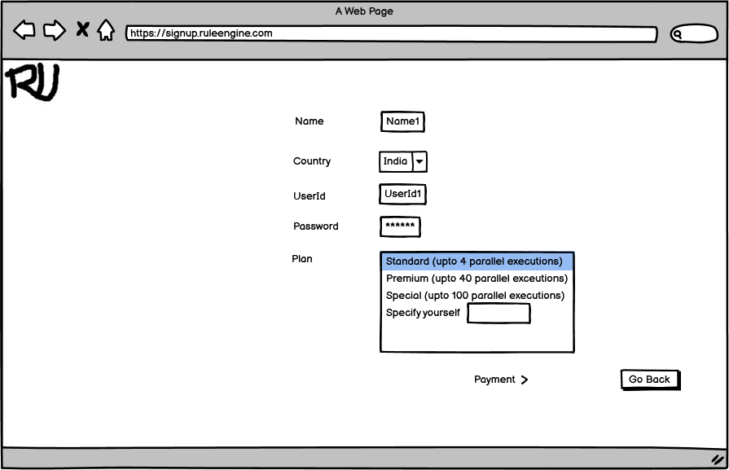
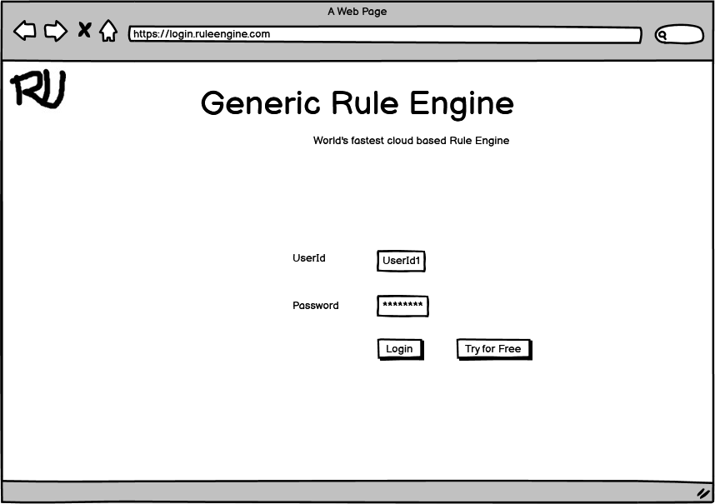
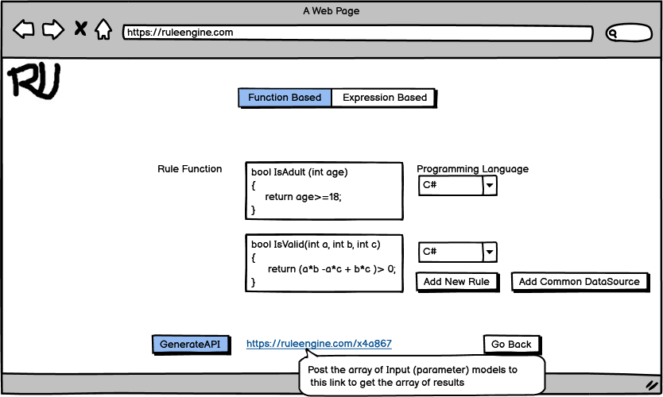
Wireframe/Prototype

Slide 7
Implementation Approaches
In the backend the product would be using below approaches for getting very high performance to the end user:
Dynamic Programming. This will be implemented through distributed caching using Azure Redis Cache. The result of a rule and input combination will be cached so that they don’t have to be recalculated.
Parallel Computing. This will be implemented through unlimited parallelization for azure functions, the rules would be deployed as azure function and they can support any workload as they are completely serverless and hence limitless.
AI and ML : The algorithms in ML can be used to simplify things, however this area is not yet explored by me.

Slide 8
Key Differentiators & Adoption Plan
The solution is better than alternatives because of below reasons:
Support of functions and expressions both.
Very high performance
Performance as a service, Performance as a third party
All types of synchronous and asynchronous communication support.
Adoption Strategies:
Create specific rule engines such as AML rule engine using the generic product and demonstrate the ease of doing it and performance of the product. How the product helped in quick detection and resolution of money laundering fraud, How a healthcare based rules on the same product helped in quick diagnosis and recovery.
Involving Industry leaders for the recommendations.

Slide 9
Future Vision
Use of data science, AI and ML to make it more performant and cheaper to the end users.
Expanding it to various domains and make it easier for industries to process validations faster.
Enabling fraud detection through this product.
Adopt and change based upon client’s feedback and needs.

Slide 10
Your Aha Moment!
Probably this product would scale to whole Azure one day 😋

Slide 11
Thank You
Deepak Mishra
vibhu12345@gmail.com
https://www.linkedin.com/in/dpakmishra/

